Slide 1
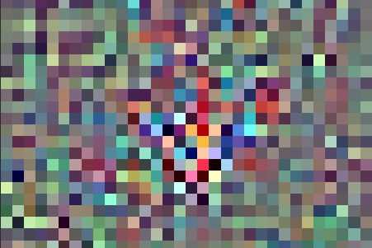
Mi-map (Misclassification of images by masquerading using adversarial patterns)
Kanishk Vikram Singh (03513302720)
Peeyush Kumar Singh (05513302720)
Tushar Bhatia (50413302720)
(Hmr Institute of technology & Management)

Slide 2

Agenda
Introduction
Scope of the work
Literature survey
Pitfalls of the work
Problem formulation
Objective
Tools and technology
Methodology
Performance parameters
Timeline
Conclusion
reference

Slide 3
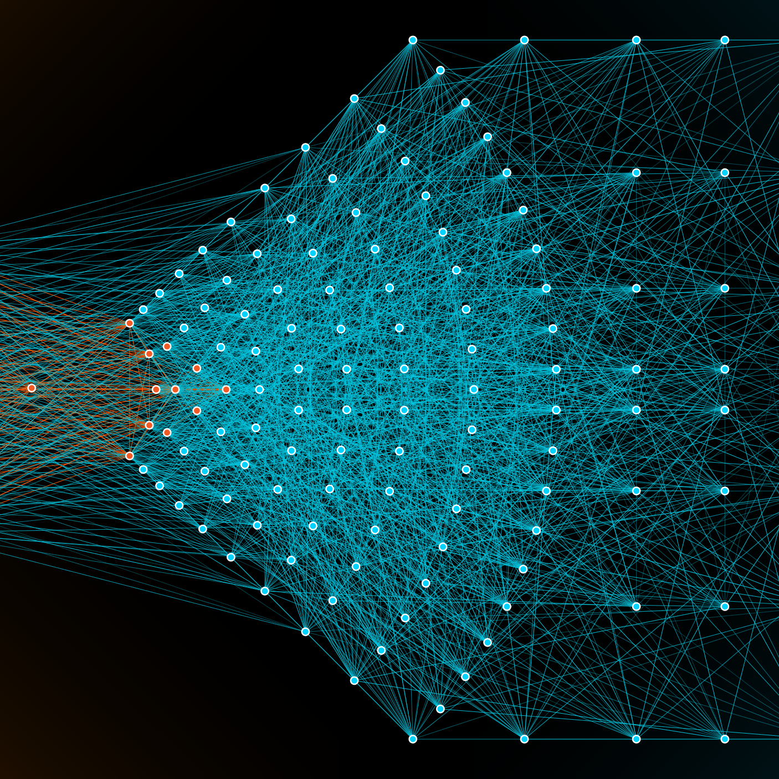
Introduction
Neural networks: The buildings blocks of simulating intelligence have greatly accelerated the decision making process in machines with minimal human intervention. As a result, they can model and learn complex, non-linear relationships between input and output data which may be harder for humans to find.
However, the majority of Neural networks like an innocuous (and presently available) network trained to drive a car could be turned to act against its owner. This is because neural networks are extremely susceptible to something called adversarial examples.

Slide 4


Scope of the work
Building classification and detection models from scratch and benchmarking their capabilities.
Evaluating pretrained models.
Exploring the methods to generate effective adversarial patterns.
studying the vulnerability of such systems by evaluating the impact of such attacks on models.
Exploring if robust and secure model designs are possible and feasible.

Slide 5
Literature survey
In "How to beat an adaptive/Bayesian spam filter (2004)“, John Graham-Cumming showed that a machine learning spam filter could be used to defeat another machine learning spam filter by automatically learning which words to add to a spam email to get the email classified as not spam.
In 2006, Marco Barreno and others published "Can Machine Learning Be Secure?", outlining a broad taxonomy of attacks.
In 2012, deep neural networks began to dominate computer vision problems; starting in 2014, Christian Szegedy and others demonstrated that deep neural networks could be fooled by adversaries, again using a gradient-based attack to craft adversarial perturbations.
In ”Explaining and Harnessing Adversarial Examples (2015)” by Goodfellow et al. an adversarial example is created using the Fast Gradient Signed Method (FGSM) attack. This was one of the first and most popular attacks to fool a neural network.
Among all the surveyed literature, it is clear that such systems can be tricked by adversarial attacks. Hence, we try to study, recreate and analyze such attacks.

Slide 6

Pitfalls of the work
Adversarial machine learning continues to be heavily rooted in academia. Hence, the practicality of it is not currently as clear cut defined.
The vast amount of computational resources required to recreate such attacks makes it difficult for everyone to test it at their end.
It is highly specific i.e. the attack patterns change from model to model as each algorithm is based upon certain assumptions about the statistical distribution of the data.
The universal adversarial patterns are hard to compute.

Slide 7

Problem formulation
Deep learning has emerged as a strong and efficient framework that can be applied to a broad spectrum of complex learning problems.
However, security of deep learning systems are vulnerable to crafted adversarial examples, which may be imperceptible to the human eye, but can lead the model to misclassify the output.
Hence, it is extremely important to provide robustness to deep learning algorithms against these adversaries.

Slide 8



objective
Exploring various techniques to generate adversarial patterns.
Understanding the weakness of machine learning models against adversarial attacks.
Designing robust and secure deep learning models by understanding their vulnerabilities.

Slide 9




Tools and technology
Python 3.11
Jupyter notebook
Tensorflow 2.13
windows

Slide 10


methodology
planning
implementation
Exploring
findings
Further work (extra)
1. Literature Review
2. Exploring proposed methodology
1. Creating classifiers
2. Evaluation
3. Generating Adversarial
4. Testing
1. Selecting pretrained models
2. Studying evaluation metrics
3. Generating Adversarial
4. Testing
1. Tabulation
2. Comparison
3. Visualization
1. Universal Adversarial
2. Linear vs Non Linear methods
3. Leveraging GANs

Slide 11

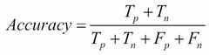
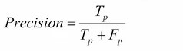
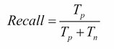
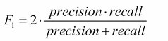
Performance parameters

Slide 12
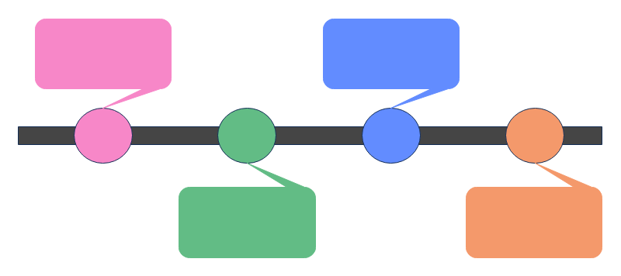
Timeline
September
October
November
December
Week 1-2
1) Planning
2) Review and survey papers
3) Preliminary implementation
Week 3-6
1) Complete implementation
2) Testing independently
3) Exploring existing models
Week 7-10
1) Rigorous Testing
2) Improvement
3) Report Findings
4) Produce relevant data
Week 11-12
1) Further work
2) Draft report
3) Report review
4) Final submission

Slide 13

conclusion
In MI-MAP, we analyze and generate adversarial patterns to intentionally manipulate the classification and detection models to either misclassify or completely refuse to detect the subject at all by adding imperceptible changes to images.
Such a comprehensive study gives us insight into the existing methods and the results will help us understand the vulnerability of such systems, methods to generate effective adversarial patterns and evaluating the impact of such attacks on model performance.
This will enable us to design reliable, robust and secure models.
Finally, the outcome of this study based project may also provide us with countermeasures for such attacks.

Slide 14

References
[1] Goodfellow, Ian J., Jonathon Shlens, and Christian Szegedy. "Explaining and harnessing adversarial examples." arXiv preprint arXiv:1412.6572 (2014)
[2] Chakraborty, Anirban, et al. "Adversarial attacks and defences: A survey." arXiv preprint arXiv:1810.00069 (2018).
[3] Wu, Jing, et al. "Performance evaluation of adversarial attacks: Discrepancies and solutions." arXiv preprint arXiv:2104.11103 (2021).
[4] https://www.tensorflow.org/

